Slide 1
Chapter 2: The Physical Layer
(Part 1)
Source: CN5E by Tanenbaum & Wetherall, © Pearson Education-Prentice Hall and D. Wetherall, 2011
COSC 439: Computing Network Principles

Slide 2
Chapter 2 (Part 1) focuses on:
  Guided Transmission Media
  Multiplexing
  Wireless Transmission
  Communication Satellites
COSC 439: Computing Network Principles
Notes:
In this chapter, we will define various terminologies used to describe transmission at the physical layer defined in the OSI reference model. In addition, we will cover the various transmission media used in computer networks.
→ Next slide

Slide 3
The Physical Layer
Foundation on which other layers build
  Properties of wires, fiber, wireless limit what the network can do
Key problem is to send (digital) bits using only (analog) signals
  This is called modulation
Application
Transport
Network
Link
Physical
CN5E by Tanenbaum & Wetherall, © Pearson Education-Prentice Hall and D. Wetherall, 2011

Slide 4
Terminology
Digital Signals
  Square wave signal taking on only a high or low value
Analog Signal
  Continuously varying signal
COSC 439: Computing Network Principles
Notes:
Digital signals are characterized by a square wave, which can either be a high or a low value. This corresponds to the two distinct values associated with binary data.
An analog signal is characterized by a continuously varying signal, represented by a sine wave. This corresponds to the infinite number of possible values that the signal can represent.
→ Next slide

Slide 5
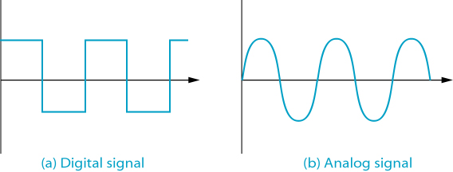
Digital and Analog Signals
COSC 439: Computing Network Principles
Notes:
A high level in a digital signal may represent a ‘1’ and a low level may represent a ‘0’. An analog signal may represent any value based on its amplitude, frequency and phase.
We will cover various encoding schemes used to represent digital or analog values using digital signals and encoding schemes used to represent digital or analog values using analog signals.
→ Next slide

Slide 6
Terminology
Bit rate (bps)
  Measure of the number of bits that can be transmitted per unit of time
Bandwidth (Hz)
  The difference between the highest and lowest frequencies that a medium can transmit
Periodic signal
  Signal that varies with time but repeats a certain pattern continually
Hertz (Hz)
  Signal measurement specifying the number of cycles per second
COSC 439: Computing Network Principles
Notes:
The following terms are used to describe digital and analog signals.
Bit rate is a measure of the number of bits that can be sent on a transmission link over a time period. Normally, this is measured in bits per second.
Bandwidth is a measure of the width of the frequency used in the transmission of data over a link. This is normally measured Hertz.
However, the terms bit rate and bandwidth are sometimes used interchangeably to describe the rate of transmission in bits per second. This is correct in most cases since bandwidth is used to determine the bit rate that is available in a transmission medium. However, for the sake of clarity, we will use the term bandwidth strictly as a measure of the range of frequencies used in a transmission medium.
A signal is periodic if a pattern repeats continually. The number of complete patterns in one second is defined a one Hertz.
→ Next slide

Slide 7
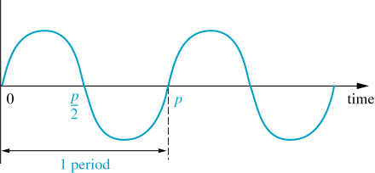
Periodic Signal
COSC 439: Computing Network Principles
Notes:
In this example, there are two complete patterns of the periodic signal.
→ Next slide

Slide 8
Communications Media
Conductive Metal
  Twisted pair
  Coaxial cable
Optical fiber
Wireless (Electromagnetic waves)
  Microwave transmissions
  Satellite
  Wireless LANs
COSC 439: Computing Network Principles
Notes:
Three type of media used in computer communications differ on the material used. Twisted pair wires and coaxial cables use copper or aluminum wires to propagate electric signals. Fiber optic cable make use of fiberglass to propagate light signals. Wireless networks use air to propagate electromagnetic signals.
→ Next slide

Slide 9
Twisted Pair
least expensive media
very susceptible to interference and noise
Types: shielded (STP) and unshielded (UTP)
Category 3 UTP:
  voice-grade
  <16 MHz
  <10 Mbps
Category 5 UTP:
  data-grade
  <100 MHz
  < 100 Mbps
amplified every 5-6 km; repeated every 2-3 km
COSC 439: Computing Network Principles
Notes:
Twisted pair wires are the most common and least expensive transmission media used in computer communications. However, the signal that is carried in twisted pair wires are very susceptible to environmental interferences and noise. Examples of interferences include lightning or electromagnetic signals generated by magnetic devices.
The common telephone wires are category 3 UTP (also referred to a Cat-3), while Ethernet cables are typically Cat-5 UTP. The category of TP wires specifies the range of frequencies (bandwidth) that are available for carrying data. The wider the bandwidth available, the larger the bit rate that the transmission medium is capable of carrying.
Since signal strength deteriorates as it propagates over the transmission medium, it is typically amplified or repeated every few kilometers to compensate for the loss.
→ Next slide

Slide 10
Terminology
Attenuation
  Degradation of a signal as it travels along a medium
Amplifier
  A device that increases the strength of a transmitted signal
Repeater
  A device that intercepts a transmitted signal before it has distorted and attenuated too badly and then regenerates the signal and retransmits it.
COSC 439: Computing Network Principles
Notes:
A signal’s quality (strength, shape) degrades as it travels over a distance along a transmission medium. To compensate for the degradation, two devices may be installed at intervals along the medium.
An amplifier increases the strength of a transmitted signal. This also means that any errors introduced in the signal is also amplified. Amplifiers are typically used on analog signals.
A repeaters are different from amplifiers because it regenerates the signal and retransmits it. An error may be introduced if the signal has already attenuated too much that the repeater will incorrectly generate a different signal. Repeaters are typically used on digital signals.
→ Next slide

Slide 11
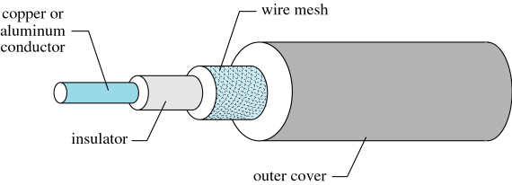
Coaxial Cable
  Bandwidth < 500 Mhz
  Data rate < 500 Mbps
  More expensive than twisted pair
  repeated every 1 km or closer for higher data rates
COSC 439: Computing Network Principles
Notes:
Coaxial cables are more expensive than TP but have a wider bandwidth available for data transmission. It can carry at most 500 Mbps compared to the 100 Mbps available in TP wires.
Also, since the conductive metal in coaxial cables is protected by several layers of cover, it is not as susceptible to external interferences and noise are TP wires. Note that the signals in coaxial cable need to be repeated more often due to the higher data rates.
→ Next slide

Slide 12
Terminology
Baseband transmission mode
  Bandwidth is devoted to a single stream of data
Broadband transmission mode
  Bandwidth is divided into ranges
COSC 439: Computing Network Principles
Notes:
A transmission medium can carry a single stream of data (baseband transmission mode) or multiple streams (broadband transmission mode). Multiple streams are created by dividing the available bandwidth into several channels, each capable of carrying a stream of data.
Cable TV service uses broadband transmission mode in their coaxial cable transmission links. The twisted pair wires used in Ethernet networks use baseband transmission mode.
→ Next slide

Slide 13
Optical Fiber
Can transmit data more quickly
transmission rate < 2 Gbps over long distances
thinner than bundled TP or coax
lower attenuation
not affected by external noise
Uses LED or laser transmitters
COSC 439: Computing Network Principles
Notes:
Fiber optic cables can transmit at a much larger transmission rate than both twisted pair or coaxial cable. The bundled fiber cables are also thinner that bundled TP or coax cables. It uses LEDs or laser transmitters to generate the light signals that propagate over the cables. Because fiber uses light signals to represent data, it is not affected by external noise. In addition, the rate of attenuation is lower in fiber optic cables, thus allowing for longer distances between repeaters.
→ Next slide

Slide 14
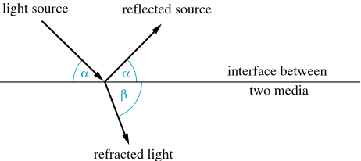
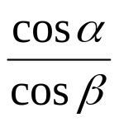
Light Refraction and Reflection
Refraction
  Phenomenon relating to the changing direction of light as it passes from one medium to another
Refraction Index =
  α: angle at which light wave intersects the boundary
  β: angle at which light wave travels from the boundary
COSC 439: Computing Network Principles
Notes:
Light that is generated by the LED or laser transmitter at the source is propagated over the fiber cable through reflection. The light signal is sent at an angle and the fiber reflects the signal which causes the light to bounce across the cable, thus propagating the signal. As the light signal the propagates, it may also be refracted. Refraction can be demonstrated by taking a glass of water and putting a spoon into the glass. The “bending” of the spoon as it enters the water illustrates refraction.
The refraction index provides a measure of the amount of refraction introduced by a medium to a light signal.
→ Next slide

Slide 15
Important:
If index of refraction is less than 1 (α > β) and α less than a critical angle
  No refracted light
  All light is reflected
COSC 439: Computing Network Principles
Notes:
→ Next slide

Slide 16
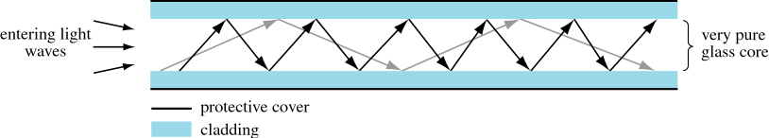
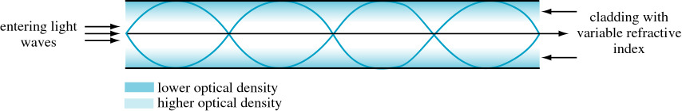
Types of Fiber
Multimode
  step index
  graded index
Single-mode
COSC 439: Computing Network Principles
Notes:
Multimode fiber cables use a larger diameter glass core. This larger diameter allows for a light source to enter the glass core at different angles or modes.
If multimode step-index fiber, the different angles that the light source enters the glass core also defines the speed that the light signal propagates in the cable. Light that is reflected more times travel a longer distance (higher angle of reflection) and will arrive at the destination later than light that travels farther each time it is reflected (lower angle of reflection). This phenomenon is called modal dispersion and may cause light from one pulse to overtake light from a previous pulse if the cable is too long. This combining of two signals translate into a steady light at the destination thus causing loss of data.
The grade-index multimode fiber cable was developed to avoid the effects of modal dispersion. This is done by using a cladding with varying refractive index, which allows for light travelling to the outer cladding to travel faster than light travelling closer to the center. This allows light travelling longer distances to travel faster, and light travelling shorter distances to travel slower thereby causing the light from the same pulse to arrive at the destination to arrive within a shorter time. Graded step-index fiber is usually used in local area networks.
Another way to prevent modal dispersion is to use a glass core radius that is small enough that it will only allow light to enter in one angle (mode). This solution, called the single-mode fiber, however, presents another problem in that in order to allow only a single mode, the diameter of the glass core has to be approximately 2x10⁻⁶ meters. This makes the cable very fragile and is therefore used mainly on long-distance trunk lines.
→ Next slide

Slide 17
Terminology
Electromagnetic waves
  Oscillating electromagnetic radiation caused by inducing a current in a transmitting antenna
  The waves travel through the air or free space, where they may be sensed by a receiving antenna
COSC 439: Computing Network Principles
Notes:
Wireless communication uses the propagation of electronic waves over the air or free space. It is transmitted and received using antenna.
→ Next slide

Slide 18
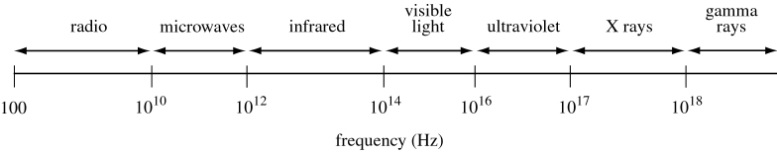
Figure 2.10
Electromagnetic Wave Spectrum
COSC 439: Computing Network Principles
Notes:
The electromagnetic wave spectrum consists of AM and FM radio waves, microwave, infrared, visible light, ultraviolet light, X rays, and gamma rays. Most wireless communications use microwave frequencies, although some LANs may use infrared signals.
→ Next slide

Slide 19
(Terrestrial) Microwave transmission
requires line-of-sight transmission
requires fewer amplifiers or repeaters
microwave antenna: parabolic dish, ~10 ft diameter
Frequencies: 2 - 40 GHz
FCC regulated: 4 - 6 GHz
COSC 439: Computing Network Principles
Notes:
Microwave communication may involve land-based transmitter/receiver antenna or satellites.
Terrestrial microwave communication typically use frequencies in the 2-40 GHz range. The distance that a microwave signal can travel is usually limited by the line-of-sight transmission requirement. This limitation is typically overcome by mounting microwave antenna in tall structures such as the top of buildings.
→ Next slide

Slide 20
Multiplexing
Multiplexing schemes share a channel among users.
  Frequency Division Multiplexing »
  Time Division Multiplexing »
  Code Division Multiple Access »
CN5E by Tanenbaum & Wetherall, © Pearson Education-Prentice Hall and D. Wetherall, 2011

Slide 21
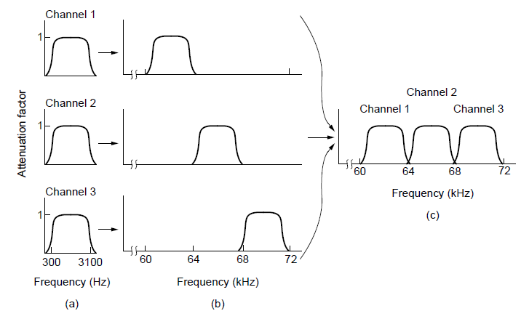
Frequency Division Multiplexing (1)
FDM (Frequency Division Multiplexing) shares the channel by placing users on different frequencies:
Overall FDM channel
CN5E by Tanenbaum & Wetherall, © Pearson Education-Prentice Hall and D. Wetherall, 2011

Slide 22
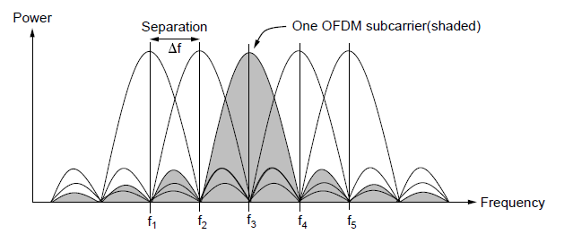
Frequency Division Multiplexing (2)
OFDM (Orthogonal FDM) is an efficient FDM technique used for 802.11, 4G cellular and other communications
  Subcarriers are coordinated to be tightly packed
CN5E by Tanenbaum & Wetherall, © Pearson Education-Prentice Hall and D. Wetherall, 2011

Slide 23
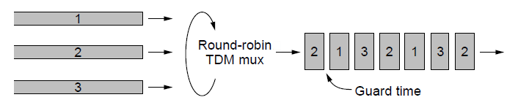
Time Division Multiplexing (TDM)
Time division multiplexing shares a channel over time:
  Users take turns on a fixed schedule; this is not packet switching or STDM (Statistical TDM)
  Widely used in telephone / cellular systems
CN5E by Tanenbaum & Wetherall, © Pearson Education-Prentice Hall and D. Wetherall, 2011

Slide 24
Code Division Multiple Access (CDMA)
CDMA shares the channel by giving users a code
  Codes are orthogonal; can be sent at the same time
  Widely used as part of 3G networks
Sender Codes
Transmitted
Signal
Receiver Decoding
+1
+1
S x A
+2
+2
Sum = 4
A sent “1”
A =
-1
-1
0
0
+2
+1
+1
0
0
Sum = -4
B sent “0”
B =
0
0
S x B
-1
-1
-2
-2
-2
+1
+1
S = +A -B
S x C
+2
Sum = 0
C didn’t send
C =
-1
-1
0
0
-2
CN5E by Tanenbaum & Wetherall, © Pearson Education-Prentice Hall and D. Wetherall, 2011

Slide 25
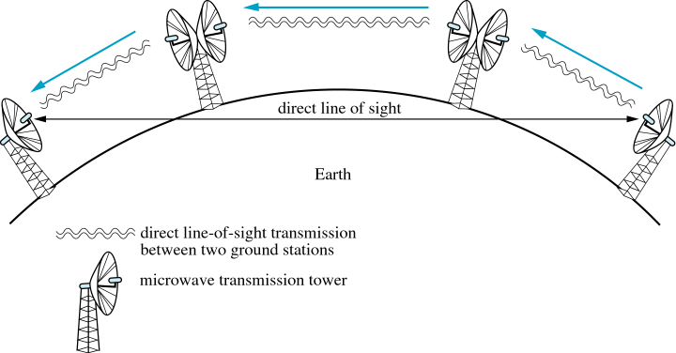
Microwave Towers used as Repeaters
COSC 439: Computing Network Principles
Notes:
Repeaters are used if the distance between the source and destination nodes is too far.
→ Next slide

Slide 26
Satellite (Microwave) transmission
microwave relay stations
Frequencies: 1 - 10 GHz
inherently a broadcast facility
longer propagation delays
COSC 439: Computing Network Principles
Notes:
Satellite transmission is an alternative to the use of terrestrial microwave antenna as repeaters. This, however, introduces longer propagation delays due to the longer distance that the microwave signals will have to travel. Satellite transmission use frequencies in the 1-10 GHz range.
→ Next slide

Slide 27
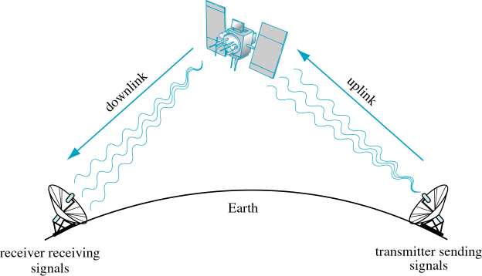
Satellite Communications
COSC 439: Computing Network Principles
Notes:
A satellite uplink uses a different frequency from the satellite’s downlink to prevent signal interference. Similarly, each satellite uses a different set of uplink and downlink frequencies. This limits the total number of satellites that can be used at the same time.
→ Next slide

Slide 28
Satellite frequency bands
L band: 1.545 – 1.66 GHz
  Used for mobile satellite communications
C band: 3.7 – 6.425 GHz
  Used for broadcast television and VSAT applications
Ku band: 11.7 – 14.6 GHz
  Used by commercial television carriers for HDTV signals
Ka band: 17.7 – 30.5 GHz
  Currently not used
COSC 439: Computing Network Principles
Notes:
The following are frequency bands defined for use for specific applications.
→ Next slide

Slide 29
Geosynchronous Earth Orbit (GEO)
Satellites are 22,300 miles or higher above the equator
Orbiting satellites that appear stationary to a ground observer 24 hours/day
COSC 439: Computing Network Principles
Notes:
Satellites are categorized based on its distance from the earth’s surface. GEO satellites are at least 22,300 miles from the earth’s equator to allow for the satellite to appear stationary to a ground observer 24 hours per day. This then allows for satellite dishes to be aimed at a fixed point in the sky at all times.

Slide 30
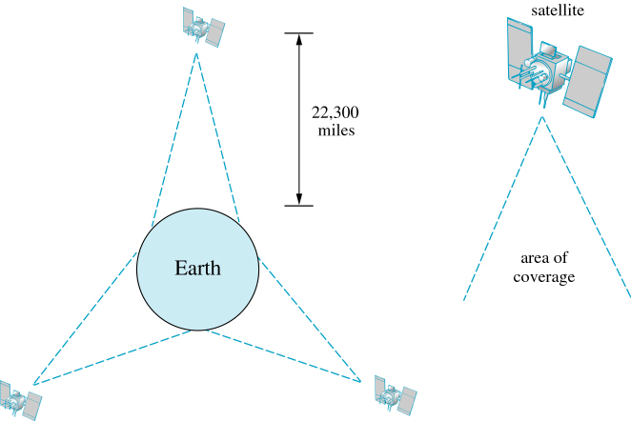
Figure 2.16 Satellites in Geosynchronous Orbit above the Equator
COSC 439: Computing Network Principles
Notes:
This figure illustrates how three equally spaced GEO satellites can cover almost the entire earth’s earth’s surface 24 hours per day.
→ Next slide

Slide 31
Low Earth Orbit (LEO) Satellites
Circular/slightly elliptical orbit under 2000 km
Orbit period ranges from 1.5 to 2 hours
Diameter of coverage is about 8000 km
Round-trip signal propagation delay less than 20 ms
Maximum satellite visible time up to 20 min
COSC 439: Computing Network Principles
Notes:
LEO satellites are much closer to the earth’s surface and thus cover a smaller area (8000 km diameter) and is visible to a ground observer for only up to 20 minutes at a time. One advantage of LEOs is that the propagation delay of signals is much less than GEOs. In addition, the area of coverage also changes instead of fixed in GEOs. A disadvantage is that a much larger number of LEOs will be needed to cover the same area that a single GEO satellite can cover.
→ Next slide

Slide 32
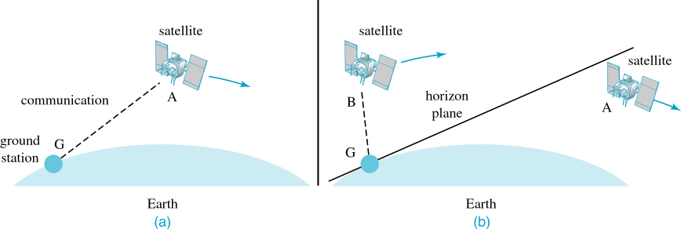
Figure 2.20 Ground Station Communicating with LEO Satellites
COSC 439: Computing Network Principles
Notes:
As LEO satellite disappears from a ground station’s view, another satellite should appear in the horizon to continue coverage of the ground station.
→ Next slide

Slide 33
Wireless LANs
Wireless LAN Applications
  LAN Extension
  Cross-building interconnect
  Nomadic Access
  Ad hoc networking
COSC 439: Computing Network Principles
Notes:
WLANs are typically used to extend coverage of an existing wired LAN, to provide connection between two structures that may be difficult to connect using wired communication (say, two buildings separated by a highway), provide for mobile communication, and ad hoc networking.
→ Next slide

Slide 34
Wireless LAN Categories
Infrared (IR) LANs
Spread spectrum LANs
Narrowband microwave
Free space optics
COSC 439: Computing Network Principles
Notes:
Infrared LANS can only be used within one enclosed area, due to the higher frequency signal used. This type of WLAN provides much better security (i.e., no eavesdropping) since signals cannot travel outside of the enclosed area.
IEEE 802.11 is an example of a spread spectrum LAN. It uses transmissions up to 2.4 GHz. Narrowband microwave LANs divide the spectrum into several much narrower channels and use each channel for individual transmissions. This avoids the collision issues common in shared media communication, but decreases the transmission rate available for each channel.
Free Space Optics is a type of WLAN that uses light beam, similar to that used in fiber optics, to transmit data between two points, but without the fiber cable. This avoids the costly and time-consuming need for setting up the infrastructure (such as digging to bury the cables). Since it is a line-of-sight technology, it is susceptible to environmental interferences such as the weather as well as objects that may cross the light beam (i.e., birds, leaves,etc.). It also provides better security since interception will be difficult since the signals are directional and can be detected when the signal is interrupted.
→ Next slide

Slide 35
Summary
Chapter 2 (Part 1) focused on:
  Guided Transmission Media
  Multiplexing
  Wireless Transmission
  Communication Satellites
COSC 439: Computing Network Principles

Slide 36
Reading Assignment
Chapter 2 (Part 2)
  Theoretical Basis for Data Communications
  Digital Modulation
  Public Switched Telephone Network
COSC 439: Computing Network Principles

